Slide 1

Key Logger - A Python-Based Keystroke Monitoring Tool with GUI
Name: Sai Amar Durgesh Kopparapu

Slide 2

PROBLEM STATEMENT
There is a need for a reliable method to monitor and log keyboard activity for security auditing, personal data backup, or user behavior analysis.
Many existing solutions lack a simple user interface or fail to categorize the specific physical state of the key (whether it was just pressed, held down, or released).
This project solves that by providing a simple, user-friendly graphical interface that quietly logs detailed keystroke data in the background without interrupting the user's workflow.

Slide 3
Project Description
This project is a desktop application built in Python that records all keyboard inputs from the user.
It features a Graphical User Interface (GUI) built with tkinter that allows the user to easily start the logging process with a click of a button.
Behind the scenes, it uses multi-threading to run the key listener in the background, ensuring the app's interface does not freeze.
The application captures detailed states of each key (Pressed, Held, Released) and exports this data locally into two formats: a readable text file (logs.txt) and a structured JSON file (logs.json) for easier data parsing.

Slide 4

WHO ARE THE END USERS?
Cybersecurity Students & Researchers: To understand how spyware functions and learn how system inputs are intercepted.
System Administrators: To audit terminal usage or monitor activities on specific local machines.
Everyday Users: To create automatic, running backups of typed text (e.g., recovering a lost essay or unsaved document in case of a crash).
Parents: To monitor their children's computer activity and online safety.

Slide 5

Technology Used
Programming Language: Python 3
GUI Framework: tkinter (for the application window and interactive start button)
Core Libraries:
pynput.keyboard: To monitor, intercept, and record the user's physical keyboard inputs.
json: To structure the captured data and save it as a JSON array.
threading: To run the keystroke listener independently so the GUI remains responsive.

Slide 6
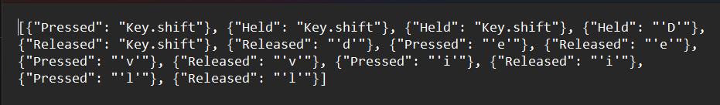
RESULTS
The application successfully launches a 250x300 GUI window with a functioning "Start Keylogger" button.
Upon clicking, it seamlessly tracks keyboard events system-wide.
The raw sequence of characters typed is successfully saved and updated in logs.txt.
A detailed, structured dictionary of events (capturing whether a key was 'Pressed', 'Held', or 'Released') is successfully updated and maintained in logs.json.
Demo Link

Slide 7
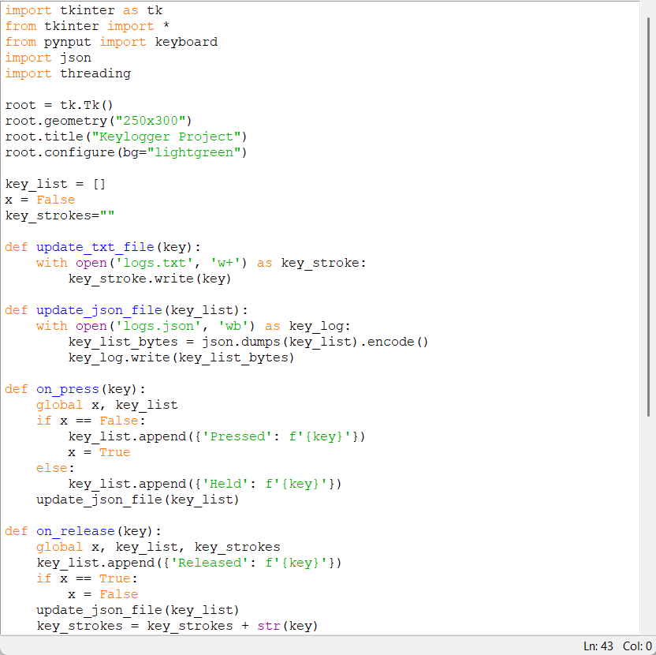
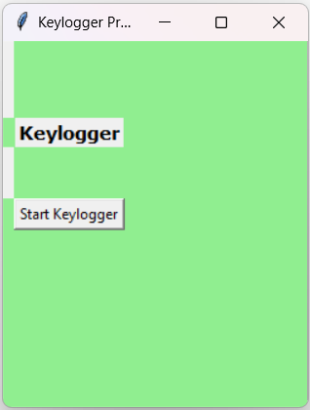
RESULTS
Demo Link

Slide 8
Thank you
.
.

